Slide 1

Getting Used to the Database of Latin Dictionaries’ New Interface
An Introduction for Long-Time Users

Slide 2
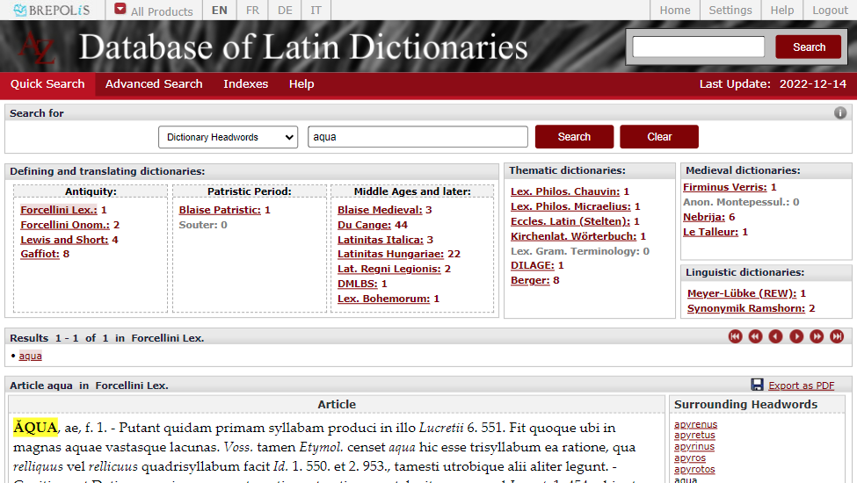
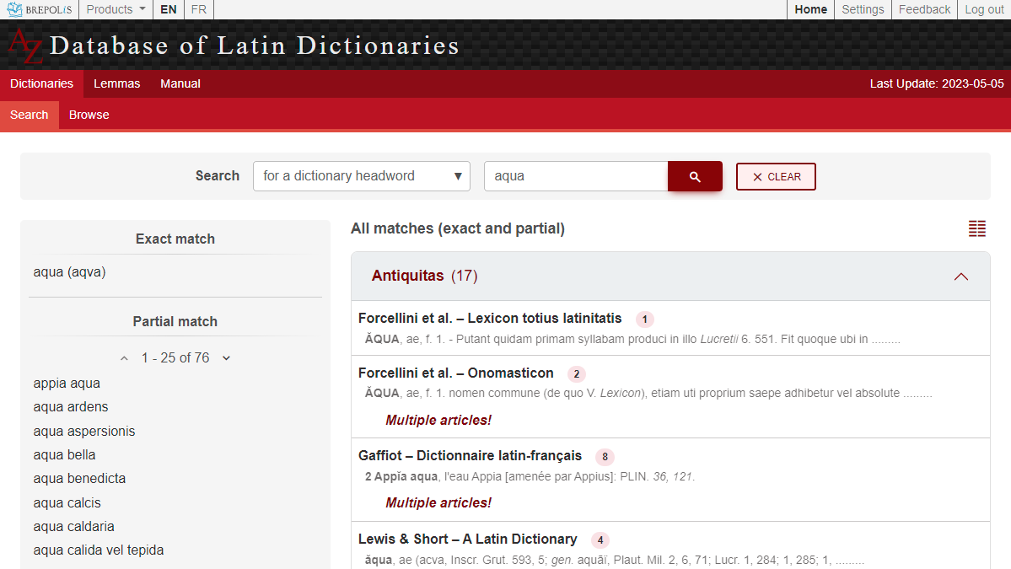
Search fields stay the same
Old
New

Slide 3
Same results, different layout
Old
New

Slide 4
Number of hits per dictionary
Old
New

Slide 5
+ preview of every first hit per dictionary
Old
New

Slide 6
Condensed view
Old
New

Slide 7
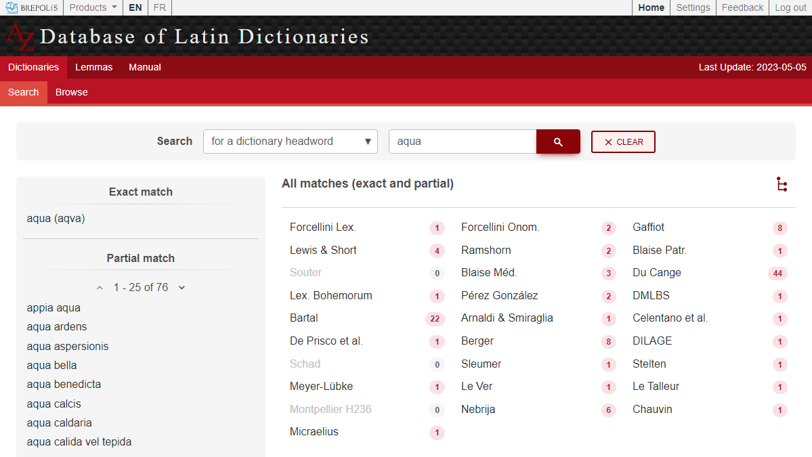
Condensed view
Old
New

Slide 8
Switch back to full view
Old
New

Slide 9
Hits in a specific dictionary
Click on a dictionary
Old
New

Slide 10
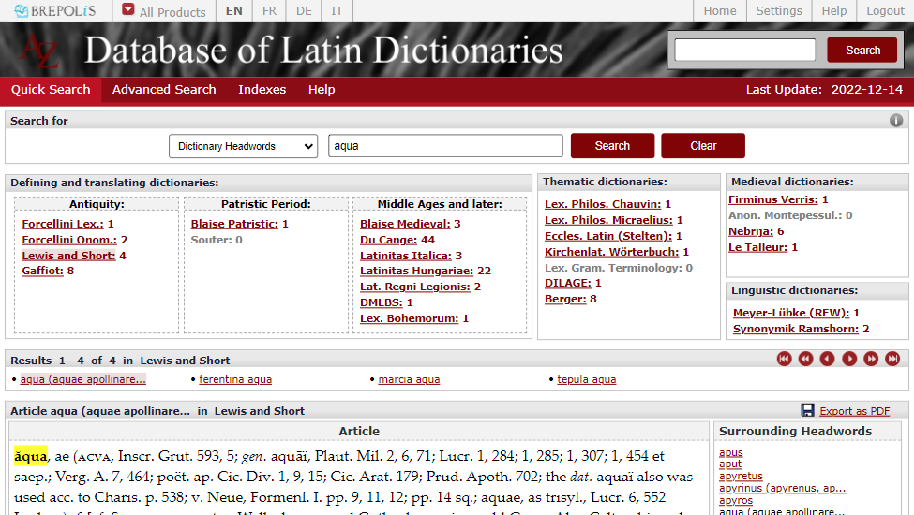
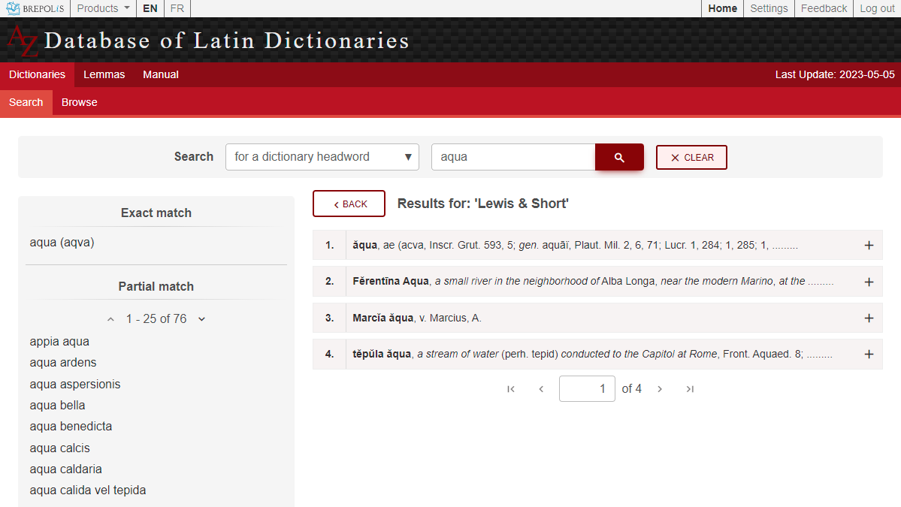
Hits in a specific dictionary
Now with preview
Old
New

Slide 11
Full article
Click on an article
Old
New

Slide 12
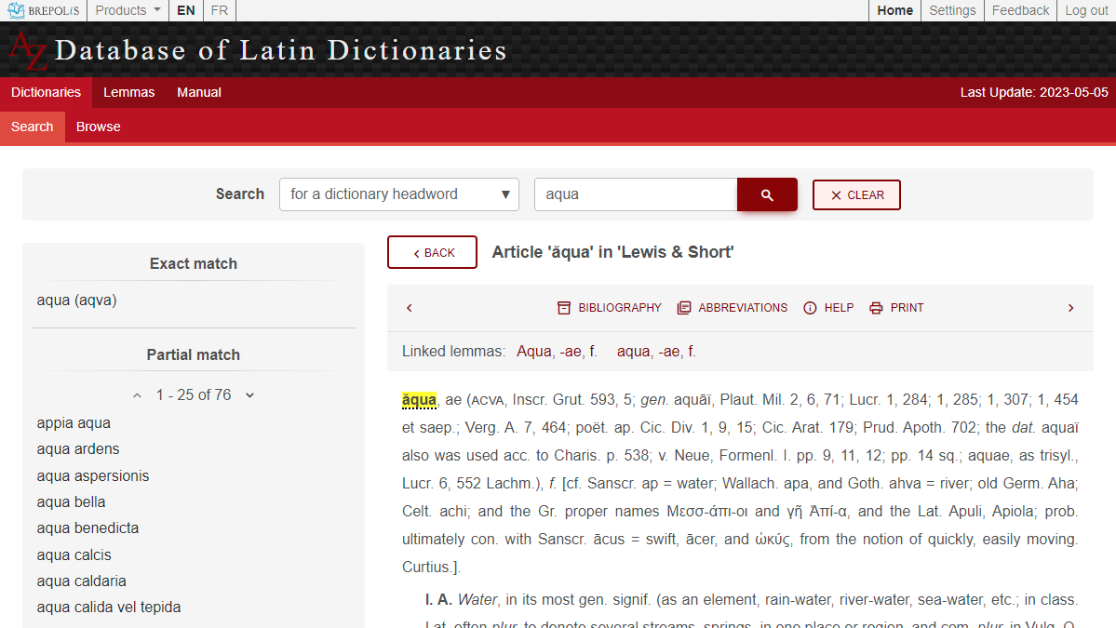
Full article
Old
New

Slide 13
Navigating between articles
Old
New

Slide 14
Exporting a full article
Print or save as PDF
Old
New

Slide 15
Focus on a Single Dictionary
Formerly:
Indexes > Dictionary headwords

Slide 16
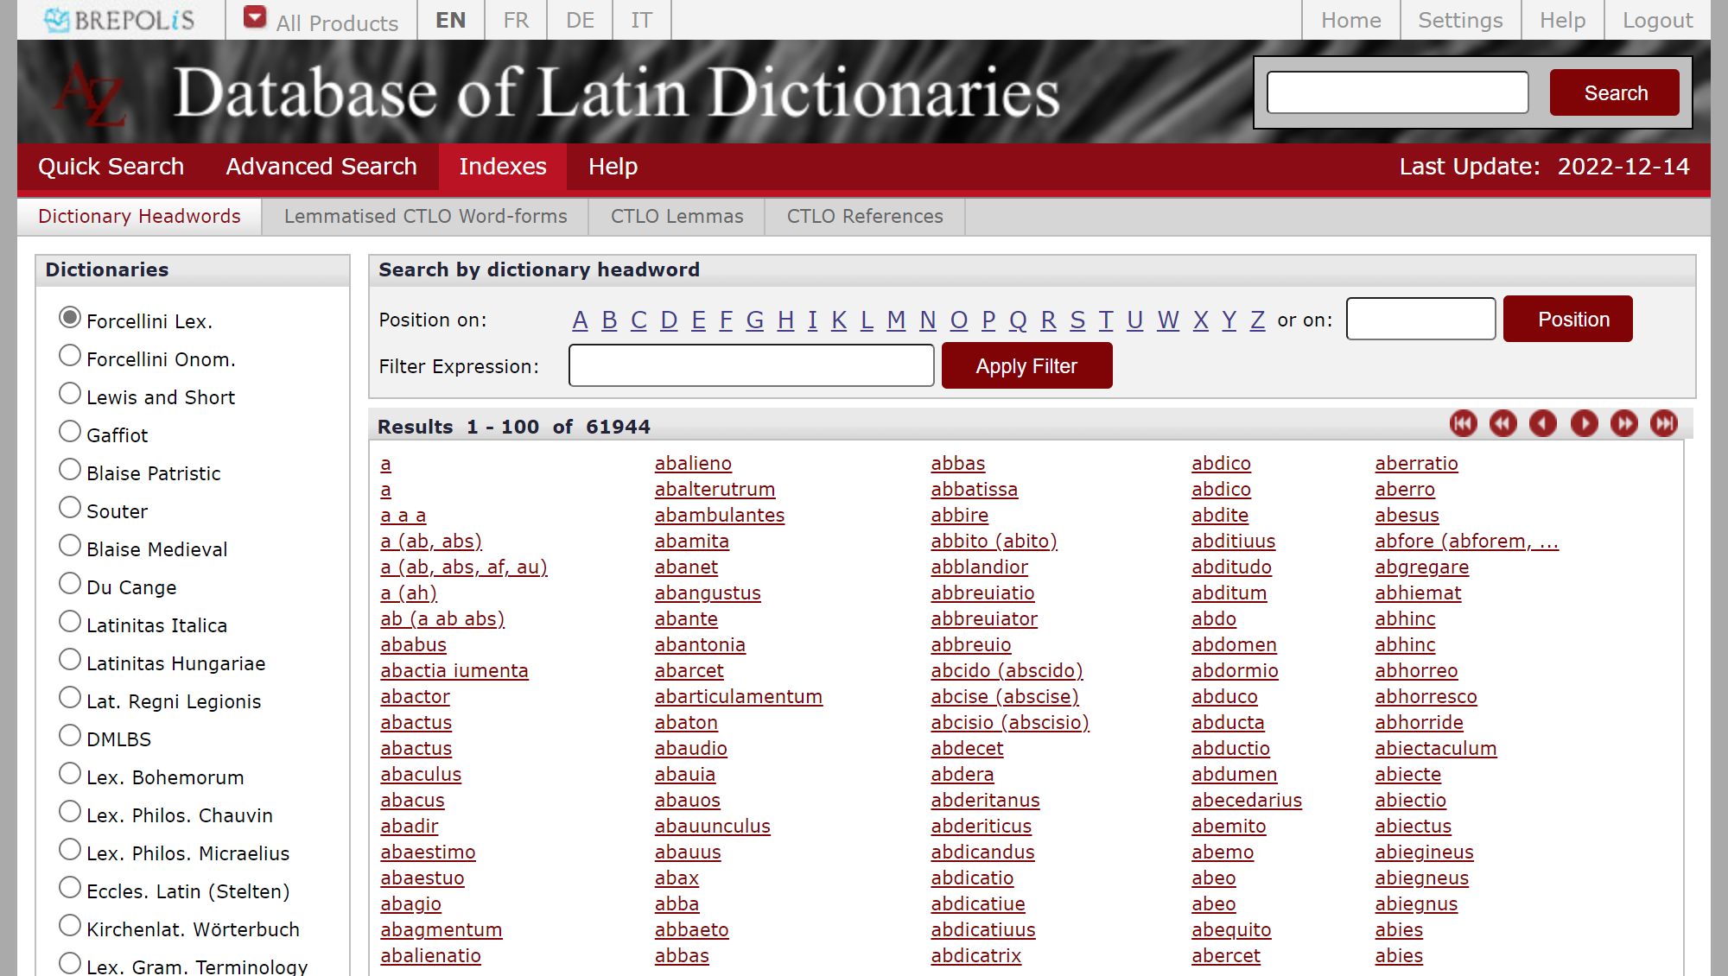
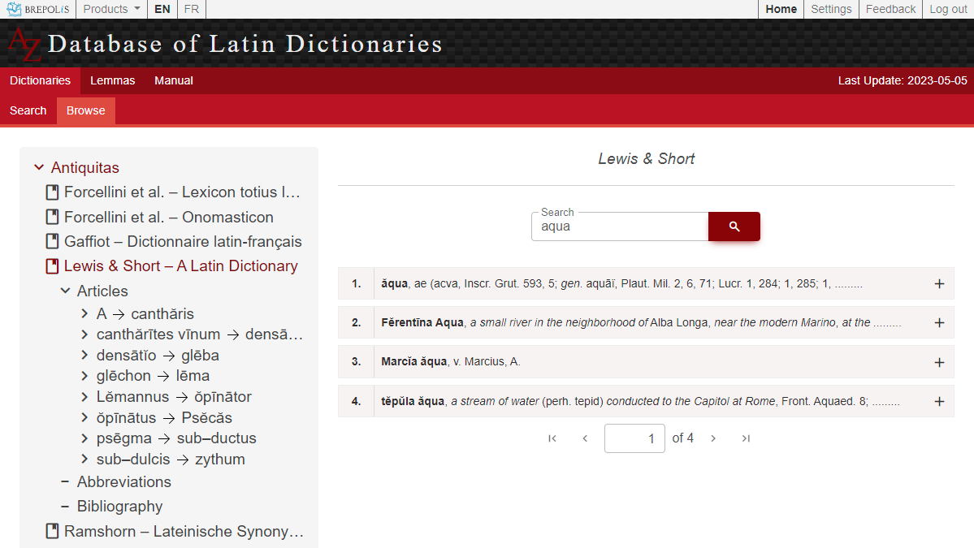
Index of dictionary headwords → Browse
List of dictionaries
Old
New

Slide 17
Index of dictionary headwords → Browse
Search
Old
New

Slide 18
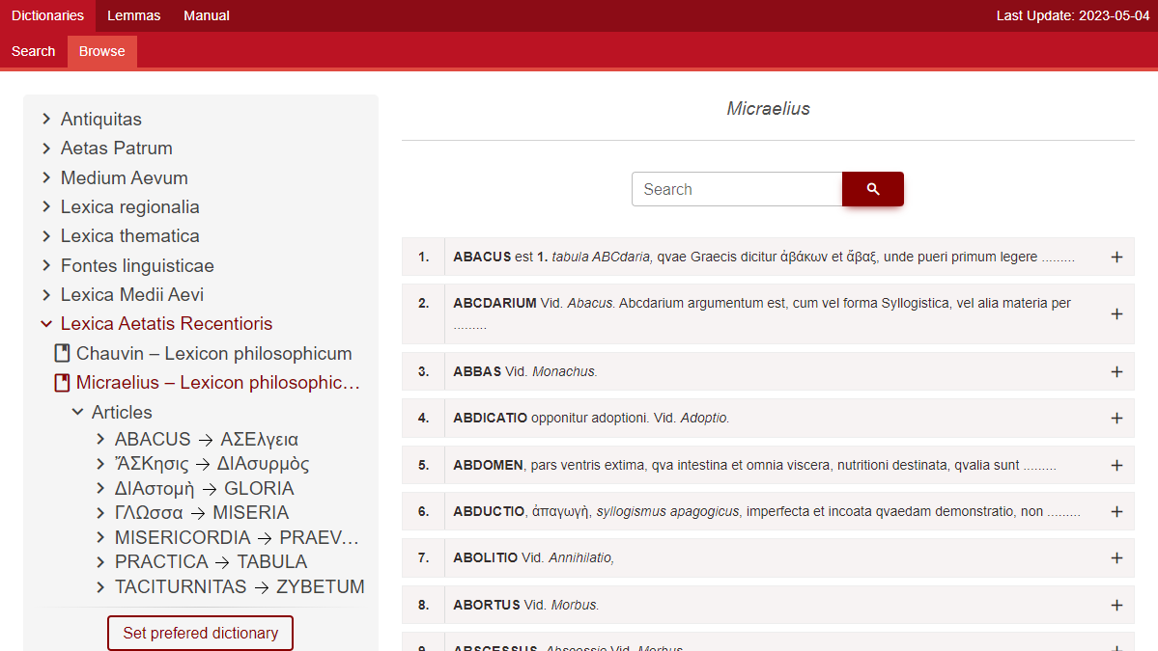
Index of dictionary headwords → Browse
Why tree structure instead of letters?
Dictionaries are not always sorted strictly alphabetically!
Old
New

Slide 19
Index of dictionary headwords → Browse
Results
with preview
Old
New

Slide 20
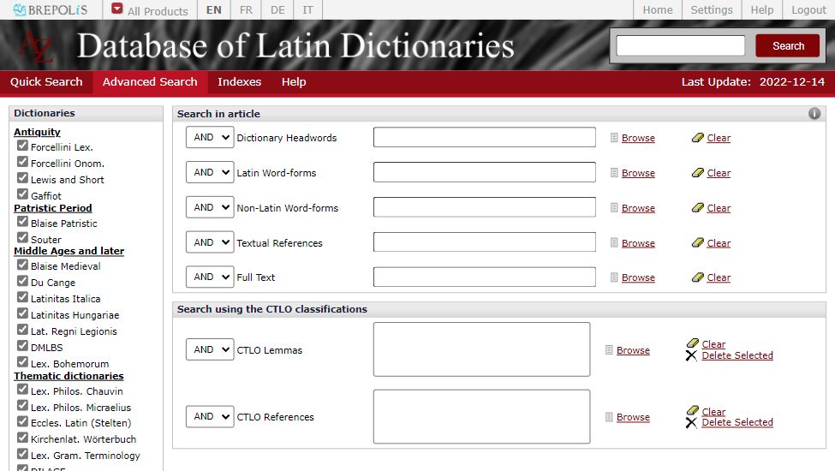
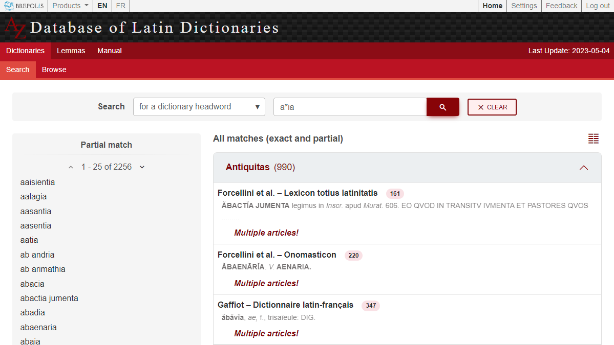
Advanced search
List of matching
headwords / translations
Removed (rarely used)
Old
New

Slide 21
Lemmas
Bridging the gap between dictionaries (lemmas) and text (words)

Slide 22
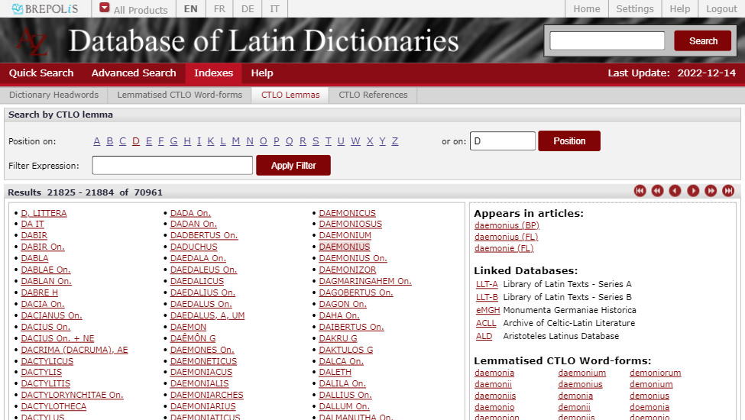
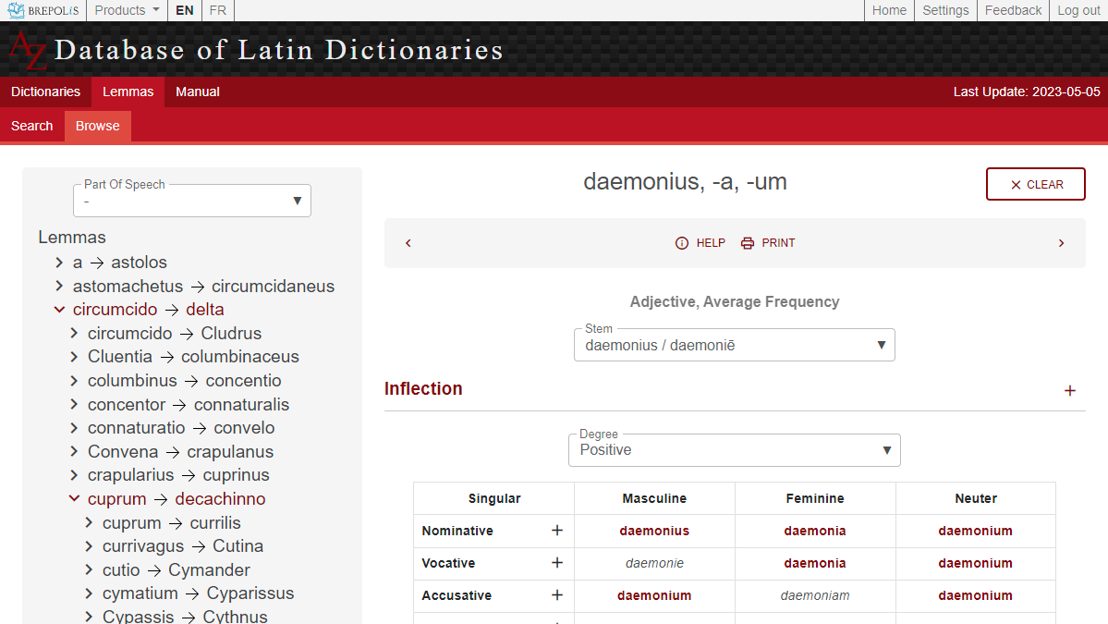
Index of CTLO lemmas is now Lemmas
Now with filter on Part Of Speech
Old
New

Slide 23
Index of CTLO lemmas is now Lemmas
No longer just a list
but highly structured
Old
New

Slide 24
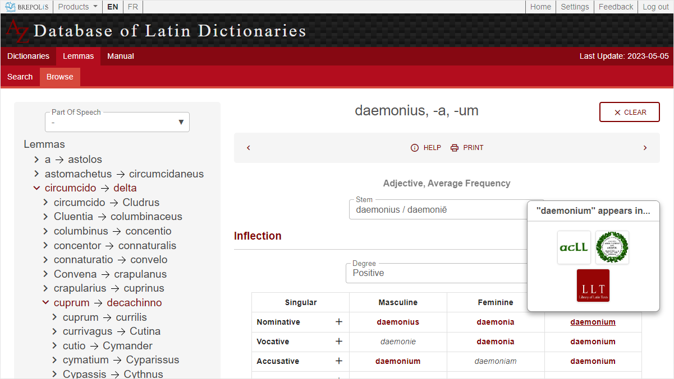
Index of CTLO lemmas is now Lemmas
Only databases with actual hits are listed.
Word-forms without hits in any full text database are greyed out.
Old
New

Slide 25
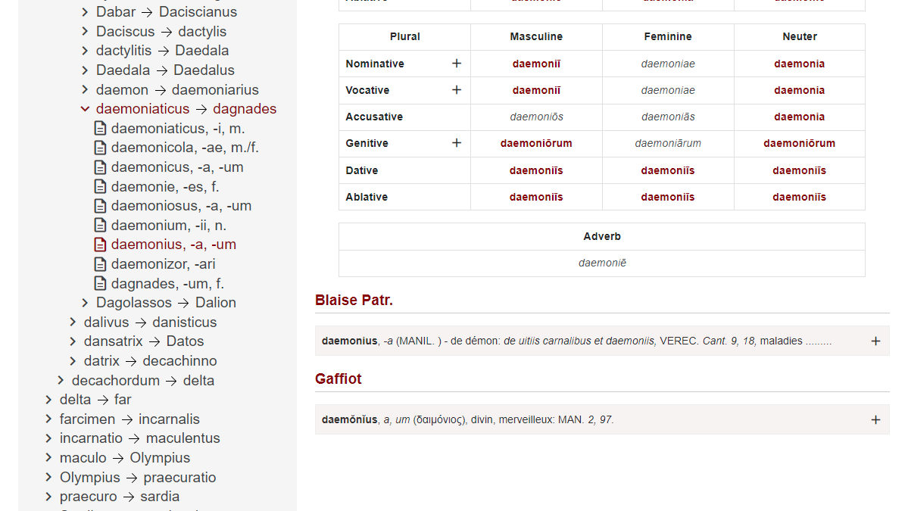
Index of CTLO lemmas is now Lemmas
Now with preview
Old
New

Slide 26
Other Improvements
Suggestions and Translations

Slide 27
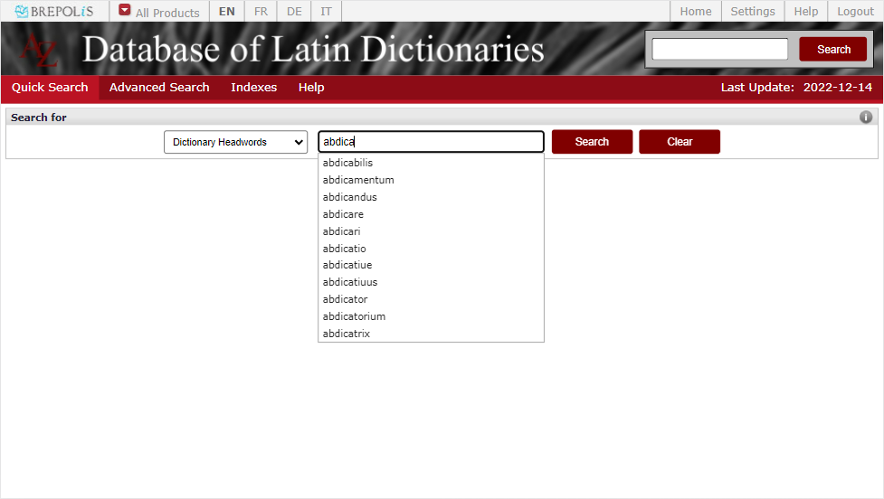
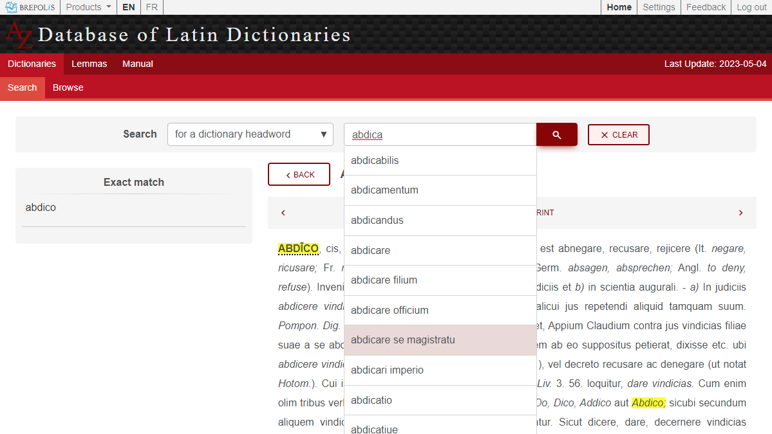
Improved suggestions
Full headwords,
not just single words
Old
New

Slide 28
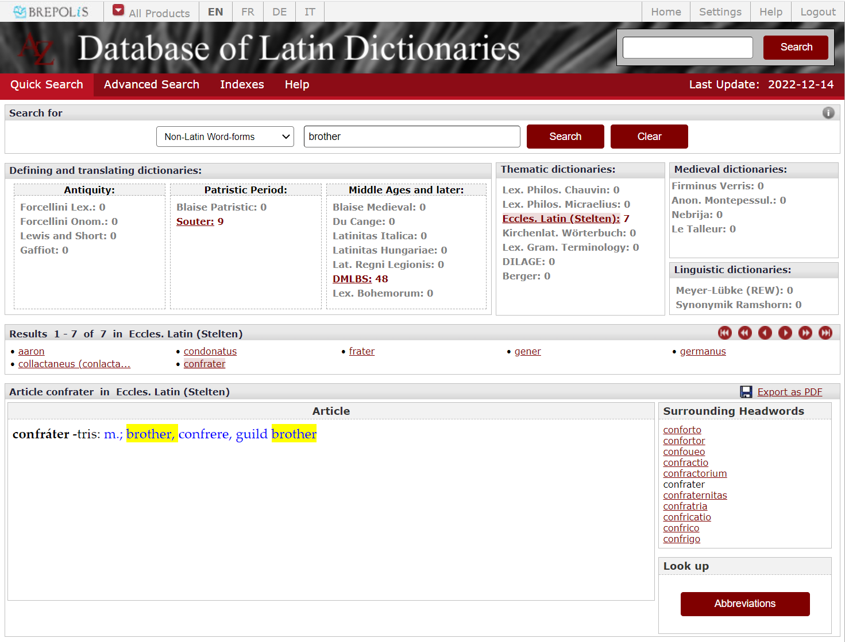
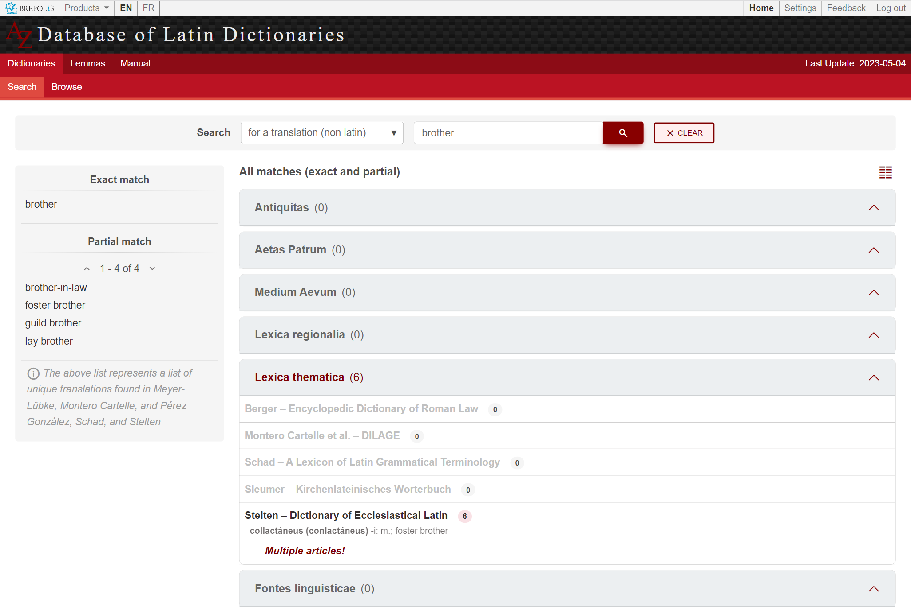
Non-Latin word-forms becomes Translations
Old
New

Slide 29
About the Translations
The concepts of ‘Latin’ and ‘Non-Latin’ Word-forms have been abandoned because they were not consistent across all dictionaries.
We now focus on dictionaries that provide straight-up translations for Latin headwords.
In the following dictionaries, we have identified the actual translation(s) and omitted all other “non-Latin”, so as to avoid false positives:
Meyer-Lübke
Montero Cartelle
Pérez González
Schad
Stelten

Slide 30
Thank you for using the DLD!
For more information, go to about.brepolis.net

