Slide 1
L’Année Philologique
Bibliography
New Interface (March 2024)

Slide 2
New interface: an overview
Bibliography
Beta version (February 2024)
Dynamic search screen
The ‘All fields’ dropdown menu consolidates the wealth of the Brepols’ bibliographies into a single, comprehensive field and brings-up the controlled vocabularies with just a few keystrokes. This new dropdown menu:
  Features filters and employs a relevance-based sorting mechanism (see below image)
  Allows the sequential selection of items from the controlled vocabularies
  Supports traditional free-text entry with Boolean and wildcard searching
Thematic search with listed click-and-pick categories facilitating combined searches across disciplines, areas and centuries
The hitlist offers comprehensive filter options, empowering users to fine tune and narrow down their search results

Slide 3
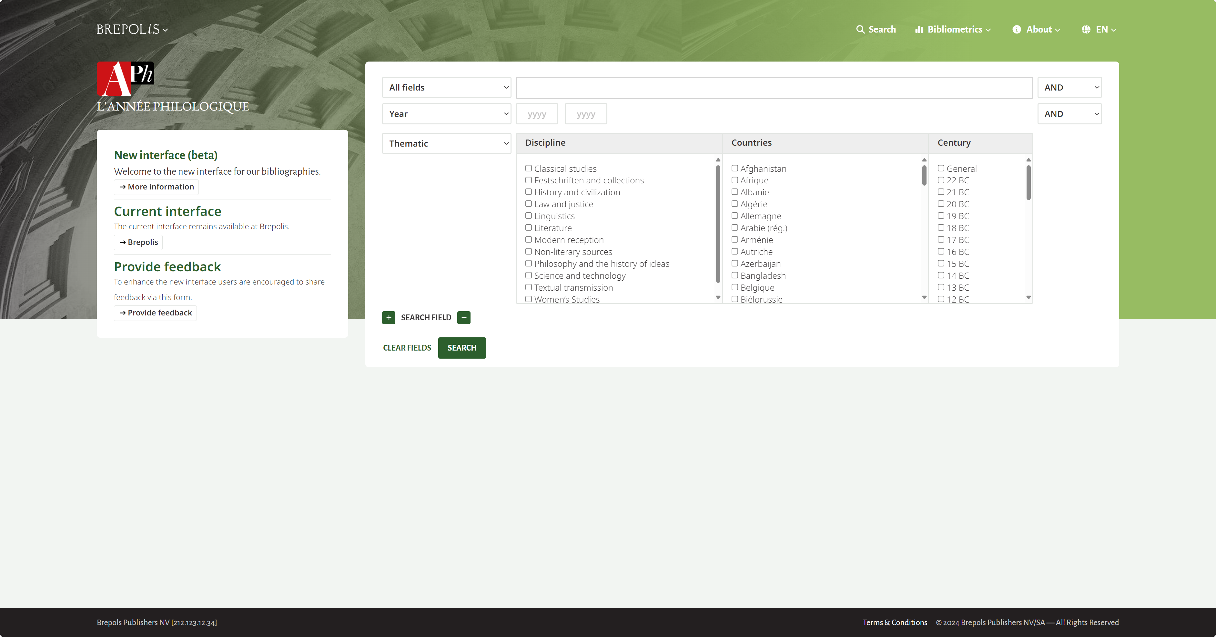
Dynamic Search Screen
Bibliography
The new dynamic search screen allows users to add or remove search fields

Slide 4
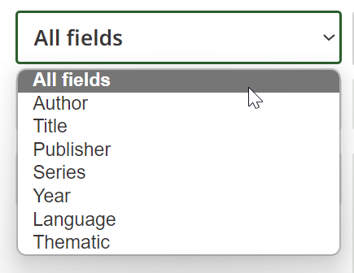
Dynamic Search Screen
Bibliography
The category of an existing search field can be changed.

Slide 5
Dynamic Search Screen
Bibliography
Search fields can be combined together with Boolean operators to limit the results

Slide 6
Dynamic Search Screen
Bibliography
The ‘All fields’ dropdown menu consolidates the wealth of L’Année Philologique into a single, comprehensive field and brings-up the controlled vocabularies with just a few keystrokes

Slide 7
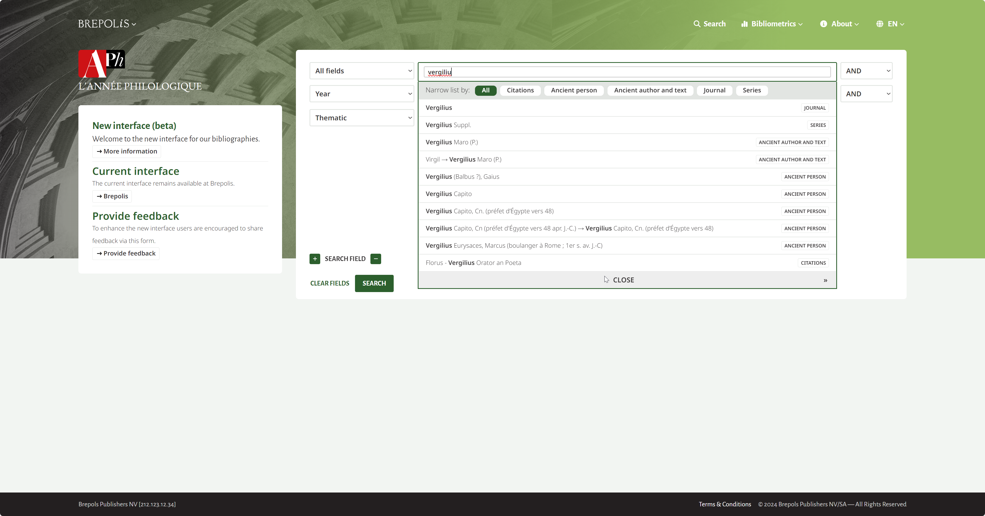
Dynamic Search Screen
Bibliography
This new dropdown menu:
Features filters and employs a relevance-based sorting mechanism
Allows the sequential selection of items from the controlled vocabularies
Supports traditional free-text entry with Boolean and wildcard searching

Slide 8

Dynamic Search Screen
Bibliography
The thematic search lists click-and-pick categories facilitating combined searches across disciplines and areas

Slide 9
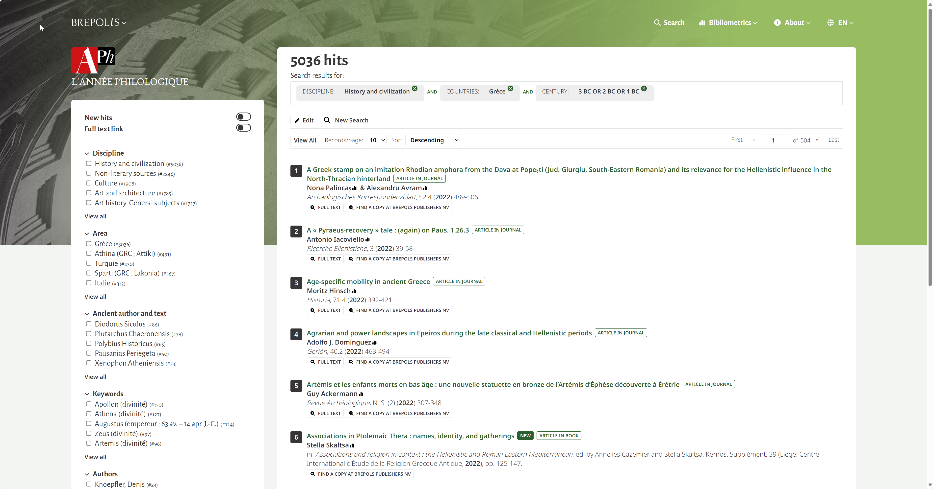
Hitlist with comprehensive filter options
Bibliography
The hitlist offers comprehensive filter options, empowering users to fine tune and narrow down their search results

Slide 10
New forthcoming functionalities (end of 2024)
Bibliography
Related publications: This upcoming feature, accessible from both the hitlist and record view, will enable users to find publications with similar classifications
The Cross-database search feature will enable users to search all subscribed bibliographies with a single query. This feature will focus on bibliographical details.
A query wizard will help users create complex searches with various Boolean and logical operators.

